Slide 1
ONLINE BOOKING PLATFORM
BY: meghana p

Slide 2

AGENDA
INTRODUCTION
PRIMARY GOALS
WORKING
ADVANTAGES
Future scoop

Slide 3
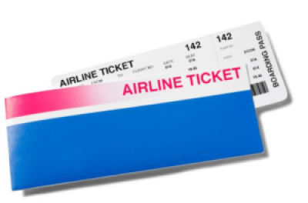
INTRO
With direct online booking of flight tickets it is easy to get tickets faster
It is a flexible online reservation system/booking system for any kind of booking
It makes it easy to manage and schedule the bookings
This Photo by Unknown Author is licensed under CC BY-SA-NC

Slide 4
PRIMARY GOALS
To make ticket reservation easy and provide a effort less experience
Fast and seem less experience of ticket reservation
Using PCs, Smartphone’s, or tablets for ticket reservation
B2B and B2C travel solution
Travel management

Slide 5
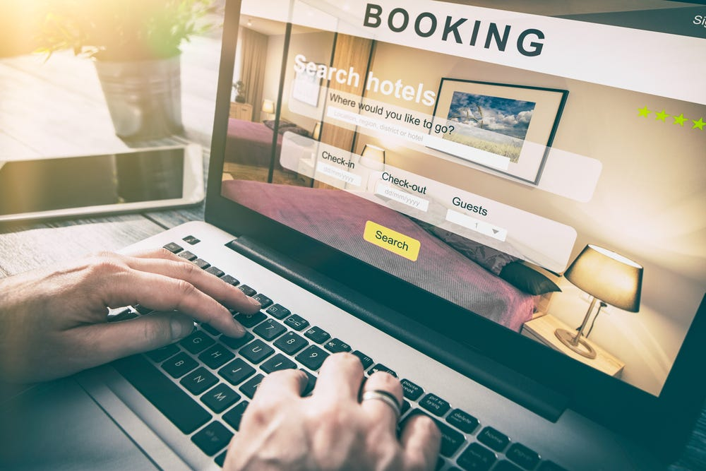
Working
Through the interface we can find flights for our travel
User gives the input of there departure, destination, date of travel and travel class
Using the inputs of the user system finds the available flights as required
User can select the flight he wants and through the payment gateway he can pay ticket fare
The interface is designed to be simple and intuitive, ensuring a seamless user experience.

Slide 6

Working
Through the interface user can manage his bookings
User can modify or cancel his journey anytime and from anywhere he wise to
Through the payment gateway user can securely pay the fare
Interface is also designed to manage the reservation

Slide 7
ADVANTAGES
Increase in bookings
Easier and Faster Payments
Mobility
Smarter Insights into the Business
SMS and E-mail automation
Secure and faster ticket reservation
Easier and simpler for a travel planning.

Slide 8
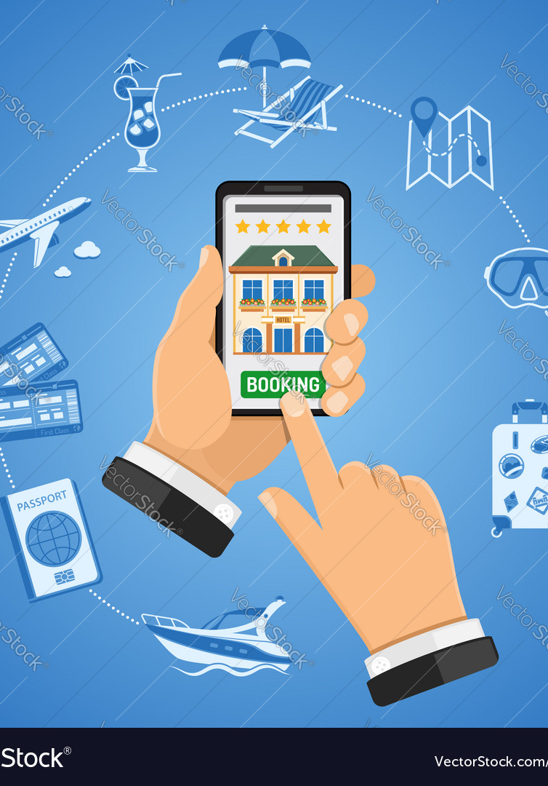
Future scoop
This interface of flight ticket reservation can be further developed for all sorts for bokings like train tickets, hotels, busses etc.
It has a scoop of further developing it into a travel agent where user can make a complete round trip
It can become a vacation planner
It can suggest new place based on your interests

Slide 9
THANK YOU
MEGHANA P
chinkupendyala12@gmail.com

